Slide 1
Microsoft Power Platform + Dynamics 365
Notes:
Hi, Welcome to Microsoft Power Platform + Dynamics 365 Bootcamp.

Slide 2
Course Overview
Day 1 – Part I
Empowering Everyone with Power Platform – From CEO to Frontline Workers
Introduction to Power Platform
Day 1 – Part II
Power Packed Day with Power Canvas Apps
Introduction to PowerApps
Day 2– Part I
Power Packed Day with Power Model Driven Apps
Let’s talk about data
Day 2– Part II
Power Packed Day with Power Automate
Introduction
Day 3– Part I
Power Packed Day with Power Agents
Introduction
Microsoft Power Platform momentum
Why Power Platform?
Customer Stories
Demo
Benefits of PowerApps
What can I build with PowerApps?
Types of PowerApps
Canvas Apps
Data Sources and Connectors
Demo
Types of Data
Common Data Service
Model-driven Apps
What type of components can I add?
Data model design
Demo
Types of flow
Data types and expression
Working with Arrays
Control flow and action settings
Demo
A Robust Virtual Agent Platform
Converse everywhere
Easily make your bots better
Create personalized customer experiences
Transfer to a human agent
Built on Power Platform & Azure Bot Service
Extend your bot capabilities with Azure Bot Service
Demo

Slide 3
Continue…
Day 3 – Part II
Power Packed Day with Power BI
Introduction
Day 4– Part I
Power up your Apps with AI Builder
Introduction
Day 4– Part II
Power Platform Administration, Security & Integration Connectors
Introduction
Day 5– Part I
Power Packed Bizz Apps Day – Sales & Marketing
Introduction
Day 5– Part II
Power Packed Bizz Apps Day– Finance & Supply Chain
Introduction
AI for every app. And everyone
Setup Environment
Types of AI Model
Prediction
Form processing
Object detection
Text classification
Demo
The 5x5 Principle
Customer momentum: Power BI
Power BI Desktop
Data sources
Power Query
Dataflow
Using a Calculation (DAX) in multiple files
Paginated Reporting
Power BI Admin Portal
Demo
Secure your tenant
Monitor your tenant’s activity
Alert & act on that activity
Connectors
SharePoint Integration
Demo
Nurture more demand
Personalize buyer experiences
Build relationships at scale
Make insight-driven decisions
Demo
How to embed Power BI in Dynamics 365 for Sales and Marketing
Technology Modernization
Modern Finance
Supporting modern supply chain management
Demo
How to embed Power Platform in Dynamics 365 for Finance and Supply Chain

Slide 4
Day 2: Power Packed Day with Power Model Driven Apps – Part I

Slide 5

Agenda
Let’s talk about data
Data→ Connectors→ Data Verse
Types of Data
Data Verse
Model-driven Apps
What type of components can I add?
Data model design
Demo
Build your model-driven app from scratch

Slide 6
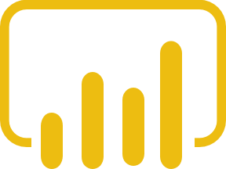



Let’s talk about data
Analyze
Power BI
Know
Act
Automate
Power App
Power
Automate
AI Builder
Learn
Notes:
Dynamics 365 can sort of be laid on top of this framework. We've got solutions for marketing, sales, service, operations, finance, talent, IoT, that sort of cover the spectrum and give you the tools you need to reimagine your processes, either department by department, function by function, or in a more holistic manner. And we're going to go through the course of the day here and sort of give you a flavor for what these capabilities are, what these technologies can provide for.
But the thing I want you to take away is that it's not just Dynamics 365 in a vacuum. We just saw Power Apps and the rest of the Power Platform being used to create even more value. Office 365, LinkedIn, Bing, all of our assets, including thousands of ISVs who built atop this Microsoft platform, it's the totality of all these capabilities that we can bring to bear to allow you to from data gain intelligence, from intelligence take action.
And so you'll see us hit on lots and lots and lots of products and services not necessarily all Dynamics but all of the products and services that Microsoft can bring to bear against this digital transformation opportunity.

Slide 7
Let’s talk about data
Analyze
Power BI
Know
Act
Automate
Power App
Power
Automate
Connectors
AI Builder
Learn
Notes:
Dynamics 365 can sort of be laid on top of this framework. We've got solutions for marketing, sales, service, operations, finance, talent, IoT, that sort of cover the spectrum and give you the tools you need to reimagine your processes, either department by department, function by function, or in a more holistic manner. And we're going to go through the course of the day here and sort of give you a flavor for what these capabilities are, what these technologies can provide for.
But the thing I want you to take away is that it's not just Dynamics 365 in a vacuum. We just saw Power Apps and the rest of the Power Platform being used to create even more value. Office 365, LinkedIn, Bing, all of our assets, including thousands of ISVs who built atop this Microsoft platform, it's the totality of all these capabilities that we can bring to bear to allow you to from data gain intelligence, from intelligence take action.
And so you'll see us hit on lots and lots and lots of products and services not necessarily all Dynamics but all of the products and services that Microsoft can bring to bear against this digital transformation opportunity.

Slide 8

Let’s talk about data
Analyze
Power BI
Know
Act
Automate
Power App
Power
Automate
Data Verse
AI Builder
Learn
Notes:
Dynamics 365 can sort of be laid on top of this framework. We've got solutions for marketing, sales, service, operations, finance, talent, IoT, that sort of cover the spectrum and give you the tools you need to reimagine your processes, either department by department, function by function, or in a more holistic manner. And we're going to go through the course of the day here and sort of give you a flavor for what these capabilities are, what these technologies can provide for.
But the thing I want you to take away is that it's not just Dynamics 365 in a vacuum. We just saw Power Apps and the rest of the Power Platform being used to create even more value. Office 365, LinkedIn, Bing, all of our assets, including thousands of ISVs who built atop this Microsoft platform, it's the totality of all these capabilities that we can bring to bear to allow you to from data gain intelligence, from intelligence take action.
And so you'll see us hit on lots and lots and lots of products and services not necessarily all Dynamics but all of the products and services that Microsoft can bring to bear against this digital transformation opportunity.

Slide 9

Types of Data
Connectors
Data Verse

Slide 10
Why internal data (Data Verse)?
It’s smart
It scales
It’s secure

Slide 11
What is the Data Verse?
The Data Verse easily structures a variety of data and business logic to support interconnected applications and processes in a secure and compliant manner

Slide 12
Data Verse
Power BI
Power
Automate
Power Platform
CDS
AI Builder
Power App

Slide 13


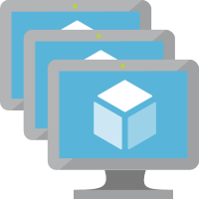




Data Verse . . . Runs on Azure
Power App
Load Balancer
Web
SQL Elastic Pools
Power Automate
Jobs
Blob
AI Builder
Sandbox
CosmosDB
Power BI
Reporting
Search
Compute
Storage
Common Data Service
Notes:
Updated icons, made some of the connections based on limited references I was able to find in the documents site.

Slide 14




Data Verse . . . Extends with Azure
Power App
Load Balancer
Web
SQL Elastic Pools
Azure Functions
Power Automate
Event Hubs
Jobs
Blob
AI Builder
Sandbox
CosmosDB
Service Bus
Power BI
Reporting
Search
App Services
Compute
Storage
Eventing + Extensibility
Common Data Service
Notes:
Updated icons, made some of the connections based on limited references I was able to find in the documents site.

Slide 15
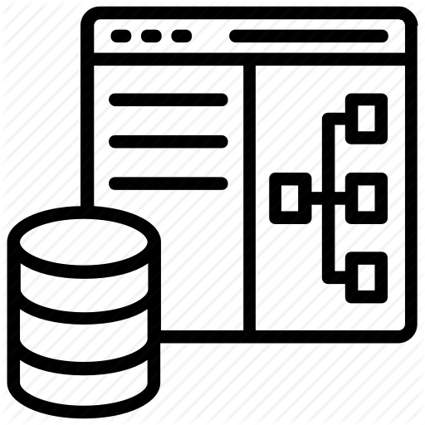
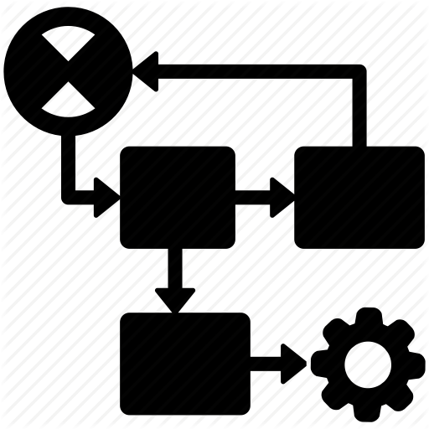




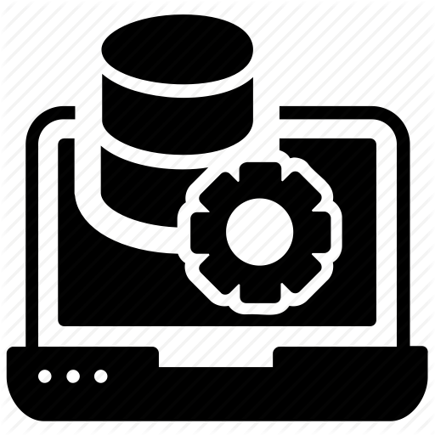

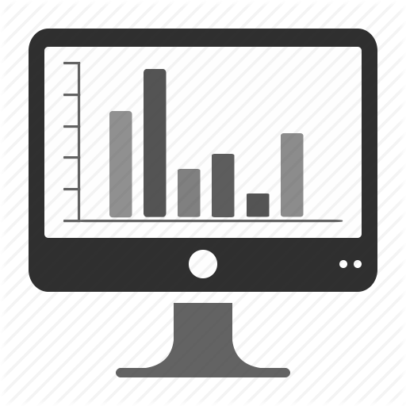







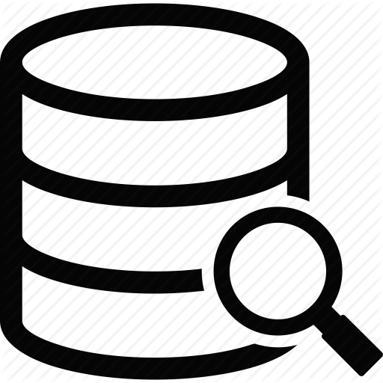



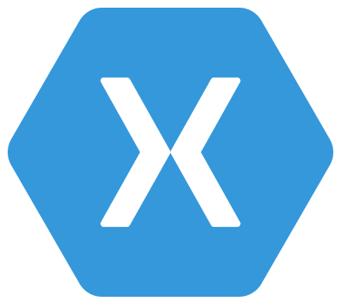

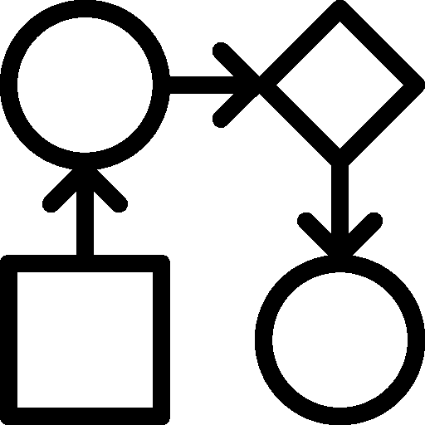
Data Verse : What's in the box
Integration
Storage
Relational
databases
Eventing
Data
Catalog
and discovery
Files and
blobs
Logic
Log files
Webhooks
Jobs
Modelling
Security
Reporting
Semi-structured
data
Business
Rules
API
Calculated &
Rollup fields
Authentication
Duplicate
Detection
Data
validation
Search and
Find data
Authorization
Plugins
Data export
Common Data
Model
Auditing
Workflows
Data lake

Slide 16
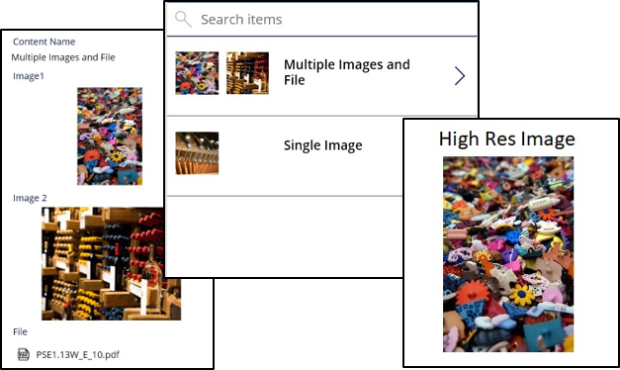
Add multiple images and rich file types to Data verse entities

Slide 17
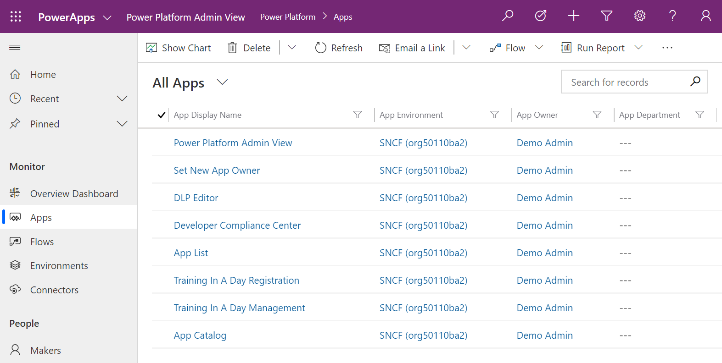
Unified Interface updates

Slide 18
PowerApps – Model Driven Apps (Forms, Views, Grids, Dashboards)
Common Data Service
API Tier
Sandbox Orgs
Application lifestyle management
SOAP API
REST API + Connector
OData API
Authentication
Integration Tier
The Common Data Service
Reporting (SSRS)
Activities (calls, meetings, mail sync)
Data Export (DES, Athena)
Data Sync (DSF Offline)
Provides storage service for both structured tabular data and unstructured data
Understands how to best store different types of data
Applies business logic over data
Logic Tier
Backup/restore (data + metadata)
Business Rules & Validation
Authorization & Security
Data Auditing & Change Tracking
Plugins, Events, Workflow
Metadata Tier
Data Model & Schema
CDM (e.g. standard entities)
Data Catalog & API
Storage Tier
Solutions &
Diagnostics
Search
Relational
File/Blob
Key/Value
Notes:
The Common Data Service
Data is arguably the most valuable business asset you have, yet, spread across applications, departments, and services. Many data and compute services have data and logic capabilities that are disjointed from each other. This often requires you to build unique data and logic stacks for each application, and because of this, it can be challenging to build integrated experiences or analyze data across apps.
This is where the Common Data Service (or CDS) comes in. Using the CDS your apps and processes can interact with a single set of data shapes and business logic.
Let me explain…
CDS is a heterogeneous storage service, for both structured tabular data and unstructured data such as images or log files. It runs in Azure and is shared by Dynamics 365 applications, Microsoft 365 and the Power Platform consisting of Power BI, PowerApps and Microsoft Flow.
CDS understands the shape of your data, and it even understands how to best store different types of data. It will automatically place image assets in blob Storage and text strings in tabular data. For example, it will shape phone number data into a specific type of text string that might be used for making phone calls.
Then beyond the shape of your data, the CDS also understands the business logic over that data. Here the CDS will aggregate values and associated activities, such as in the case of a customer it might maintain related relevant data for that customer, including minimum, maximum, average transaction size and the sum total.
T: To support a consistent way of shaping and connecting your data, we’ve open sourced the schemas we use in CDS – this is the foundation of what we call the Common Data Model or CDM.
<click>
Summary: At the core, the Common Data Services is a Microsoft Azure-based Cloud data storage service that allows you to surface data from multiple applications (including Dynamics 365, Office 365, and other similar Azure or non-Azure-based services) and make them all available at the central place.

Slide 19
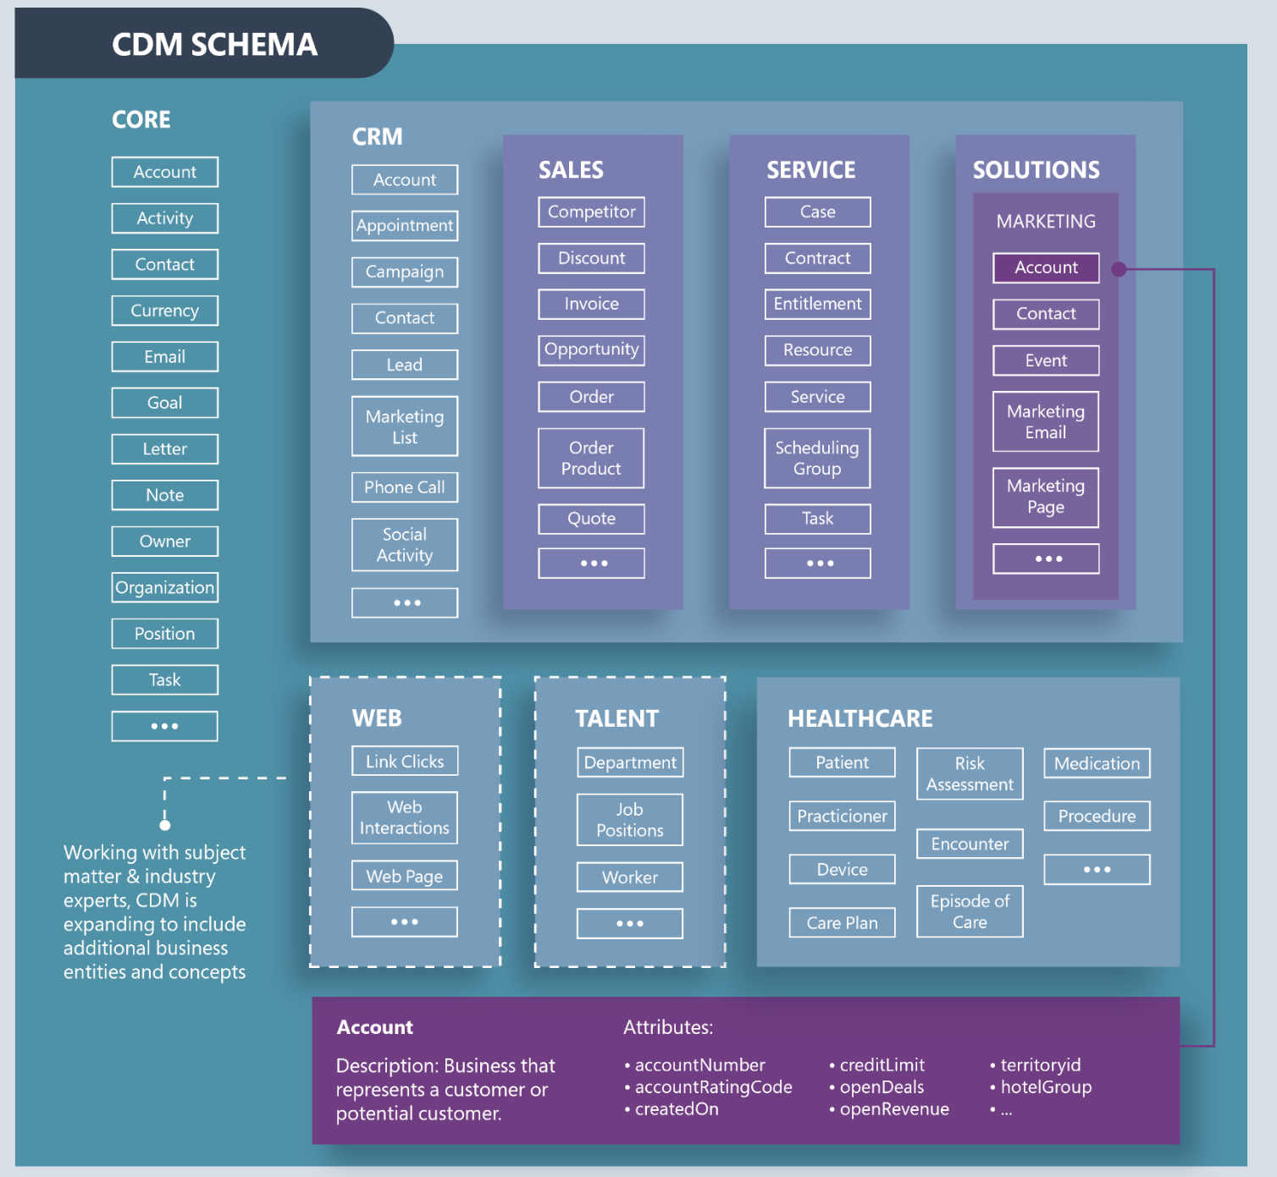
The Common Data Service
Unifies data in semantic consistency
Open-source
Growing selection of solutions that store data in CDM form
Notes:
The Common Data Model
CDM defines entities, attributes, semantic metadata, and relationships to provide consistency in how data is defined and connected across applications. And our partners across industries like Healthcare, Retail, Financial Analytics, Education, and Automotive have helped extend the CDM with industry-specific, common interoperable schemas.
The CDS is also a powerful source for analytics that you can integrate with other data sources.
Using Power BI Dataflows, you can also export data from the CDS into an Azure Data Lake or your preferred location, for analysis. Conversely, you can transform your data into CDM form using Power BI dataflows, making it ready for the CDS or other services to access.
Connectors
Then to integrate your systems and business processes with Dynamics 365 and the Common Data Service, there are hundreds of pre-built connectors covering popular data platforms and Apps to allow you to connect to your existing systems for both read-only processes—such as a one-time batch operation—and read-write communications, such as order fulfillment.
These connectors take care of which App API’s to call, how to authenticate, and how to pass data back-and-forth between applications with shared workflows.
This now makes it easier to query, interact with, and exchange information — whether that’s Dynamics 365 data, or data within your office collaboration tools, internal databases, external systems such as Adobe and SAP or in professional and social networks such as LinkedIn and Twitter.
You can also create your own connectors for your internal apps, and if you’d like more granular control, Microsoft Azure provides the developer tools and languages of your choice to do more custom development
T: So how do we enable all of this to work together?
<click>
---------------------------
For additional information, go to https://github.com/Microsoft/CDM/blob/master/docs/CDMPoster_a3.pdf
CDM is an open-sourced definition of modular and extensible business entities with semantic metadata that simplify the challenges of application development and data integration.
CDM unifies data in a well-known schema with semantic consistency.
App developers and backend integrators can develop independently.
Enables quick application deployment and development, out-of-the-box intelligence, and much more.
There’s a growing collection of solutions that store data in CDM form:
Power BI
Dynamics 365
PowerApps
Azure
The Common Data Model simplifies this process by providing a shared data language for business and analytical applications to use. The Common Data Model metadata system enables consistency of data and its meaning across applications and business processes (such as PowerApps, Power BI, Dynamics 365, and Azure), which store data in conformance with the Common Data Model.
In addition to the metadata system, the Common Data Model includes a set of standardized, extensible data schemas that Microsoft and its partners have published (ODI). This collection of predefined schemas includes entities, attributes, semantic metadata, and relationships. The schemas represent commonly used concepts and activities, such as Account and Campaign, to simplify the creation, aggregation, and analysis of data.
In other words, the Common Data Model offers these benefits:
Structural and semantic consistency across applications and deployments.
Simplified integration and disambiguation of data that’s collected from processes, digital interactions, product telemetry, people interactions, and so on.
A unified shape where data integrations can combine existing enterprise data with other sources and use that data holistically to develop apps or derive insights.
Ability to extend the schema and Common Data Model standard entities to tailor the model to your organization.

Slide 20






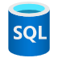


Azure + Power Platform = Build apps faster than ever before
Power Platform
Every Developer
Power BI
Power Apps
Power Automate
Power Virtual Agents
Azure services
Pro Developer
Azure
DevOps
API Management
Azure Functions
AKS
Cognitive Services
Azure Data Services
SQL Azure
Cosmos DB
Azure Data Lake
SQL Data Warehouse
Visual
Studio
VS
Code

Slide 21
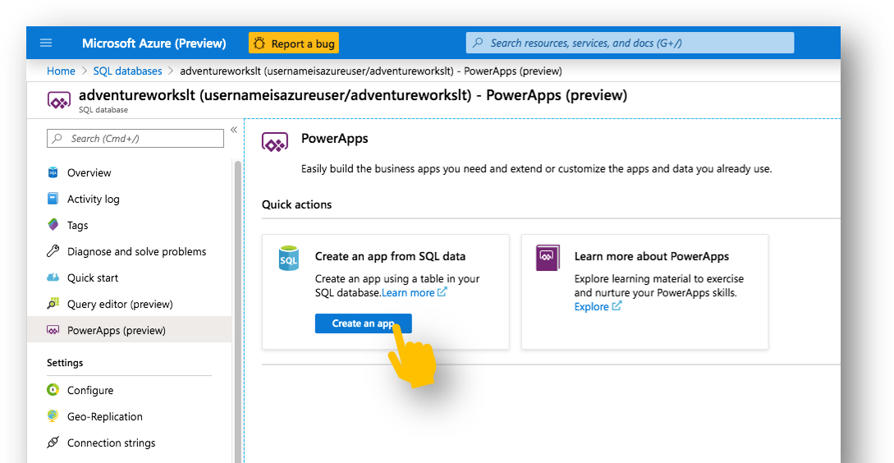
Deeper integration with Azure resources

Slide 22
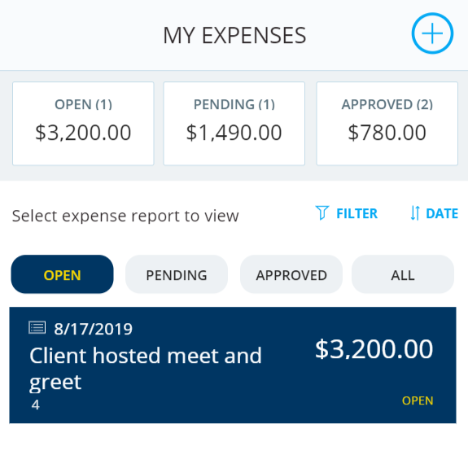
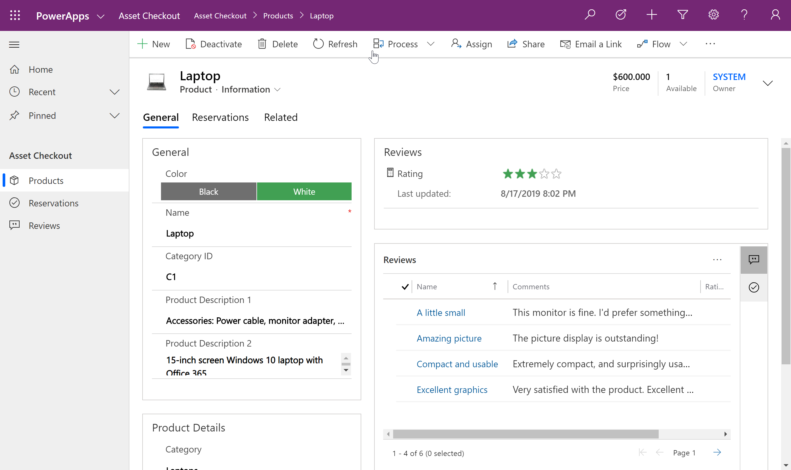
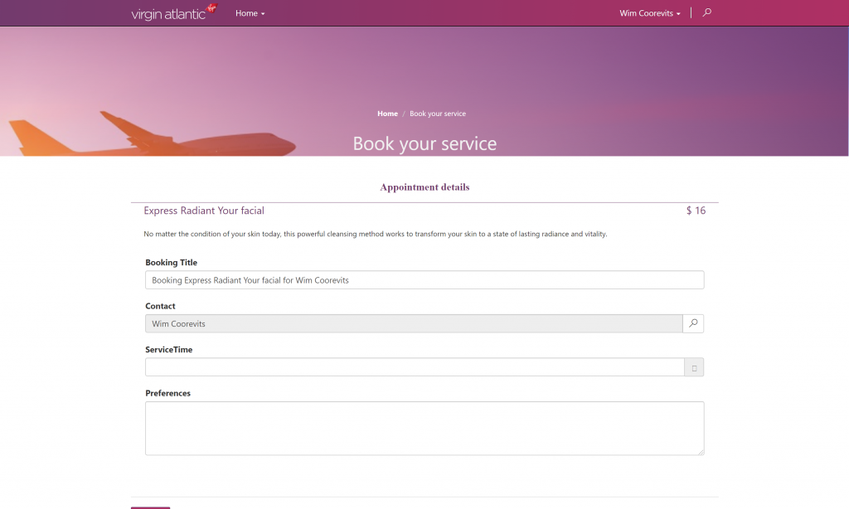
Types of Power Apps - Model Driven Apps
Canvas Apps
Model Driven Apps
Portals

Slide 23
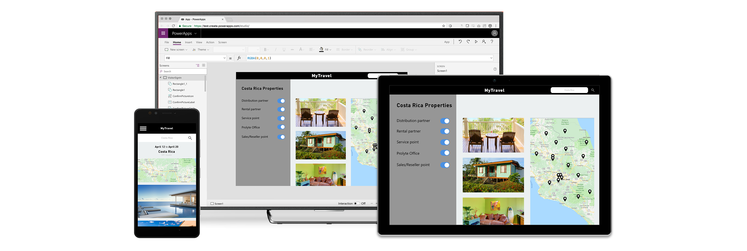
Put your data to work with the Common Data Service
“Out-of-the-box” data store for your apps
Advanced security, business logic and rules
Jumpstart apps with the Common Data Model
Dynamics 365, Office 365, and Azure data is available, augmented by industry partners
Extend to your own needs and integrate across your apps and services

Slide 24
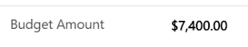

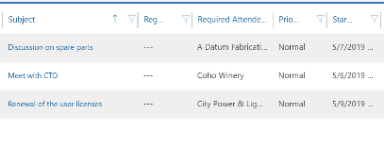
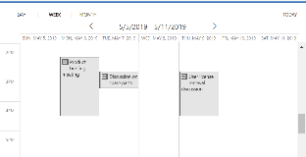
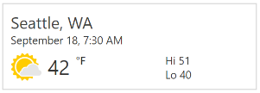
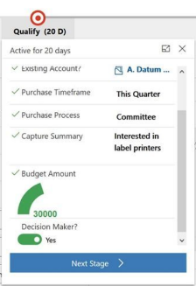
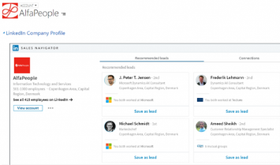
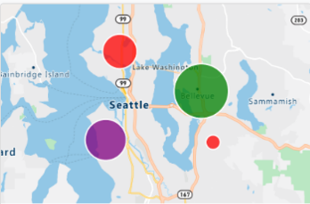
What type of components can I add ?
Field control on the form
Entity grid\sub grid
Unbound controls
Business Process step
Display external content
Utilize external services

Slide 25
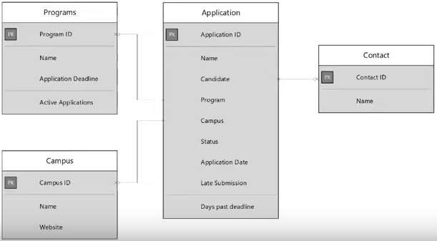
Data model design
Option Sets
Entities
Fields Data type
Relationships
Field mapping

Slide 26

Demo
Build your model-driven app from scratch
Notes:
https://docs.microsoft.com/en-us/powerapps/maker/model-driven-apps/model-driven-app-overview
https://docs.microsoft.com/en-us/powerapps/maker/model-driven-apps/build-first-model-driven-app
https://docs.microsoft.com/en-us/powerapps/maker/model-driven-apps/model-driven-app-components

Slide 27

Power On your Power Apps journey
Samit Saini

Slide 28

Start learning
Accessible online learning for citizen developers, IT admins and professional developers.
Step-by-step guidance and extensive documentation from high level concepts to advanced topics.
Structured learning journeys guide makers through scenarios with a gamified badging system.
Start learning today: https://docs.microsoft.com/en-us/powerapps/ for resources by customer persona

Slide 29


Start innovating
5 steps to your first app!
Get started free: https://make.preview.powerapps.com/home
See what our customers are doing
Attend an AIAD session
Use our guided learning
Use a template to solve a problem
Need help?
Visit our support page
Ask about Power Apps premier support options.
Microsoft services offering for a Power Platform COE: http://aka.ms/coeforpp

Slide 30

Accelerate with community
Join our community. Ask questions and engage: https://powerusers.microsoft.com/t5/Forums/ct-p/PA_Comm_Forums
Local Power Apps user groups. Great way to network, grow your skills, discover opportunities and have fun.
Join online or find a user group to join near you https://www.powerappsug.com/home
Power Platform summit. Delivers the can’t-miss annual conference for users of the Microsoft Power Platform: Find one near you: https://www.powerplatformworldtour.com/home

Slide 31


Leverage partner expertise
Search and test drive partner solutions
Standalone apps to extensions. Over 5000+ apps to browse at appsource.microsoft.com or find solution showcases at https://powerapps.microsoft.com/
Partner consulting services
From packaged consulting offerings to general services, search and find experts near you: https://appsource.microsoft.com/
Attend a partner led app in a day
Free one-day workshops where you will learn how to create custom business applications: https://aka.ms/AIADEvent

Slide 32

Turn your bright ideas into brilliant apps with Power Apps today
Nazma Bashir
Notes:
500 applications are going to be built in the next 5 years. Make yours matter.

Slide 33
Thank you

